Slide 1
Kalman Filter Demo
https://github.com/RenzDot

Slide 2
Kalman Filter for Positional Data
Target Tracking
Noise reduction
Memory efficient
Source: https://www.kalmanfilter.net/default.aspx

Slide 3
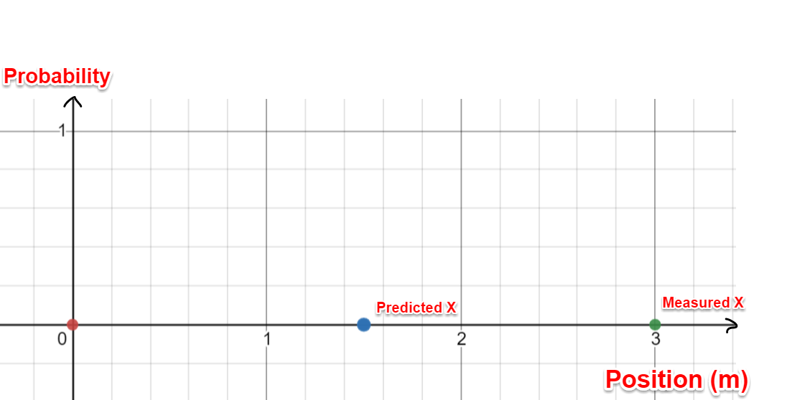
Predicted x
x _{Predicted} = x + v*t
- Predicted x

Slide 4
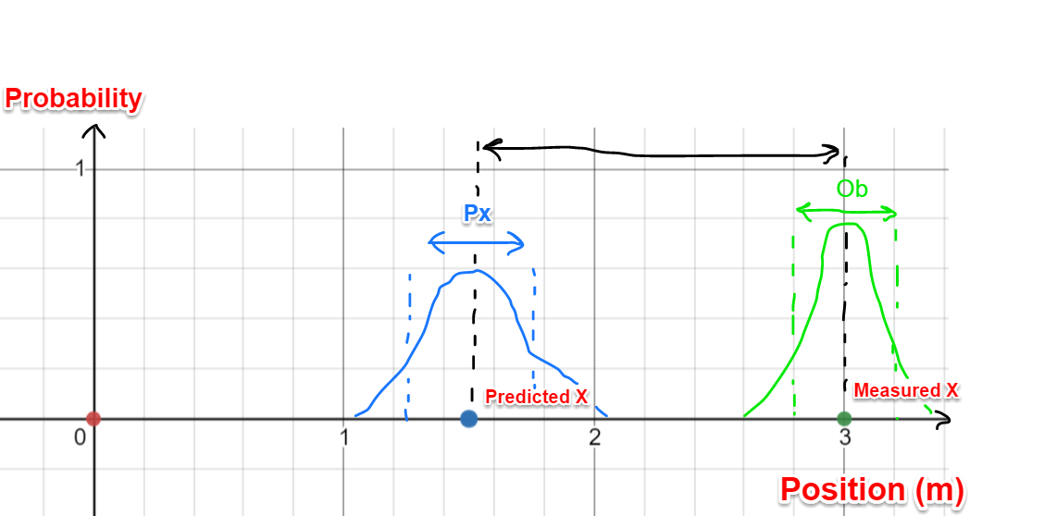

Gaussian Distribution & Variance
x _{Predicted} = x + v*t
- Predicted x
- Uncertainty of Prediction x
Ob = Ob
- Uncertainty of Measurement
Pre-Calculated Constant

Slide 5
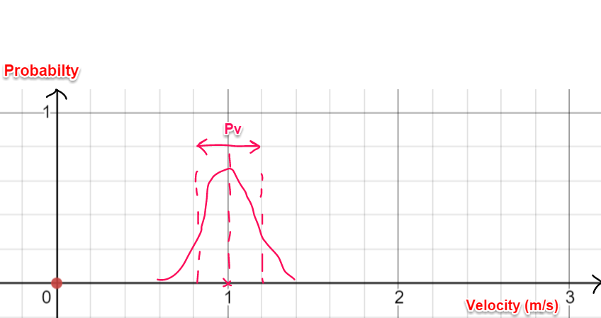

Gaussian Distribution & Variance
- Uncertainty of Prediction x
- Uncertainty of Prediction v
v = v
- Predicted Velocity

Slide 6
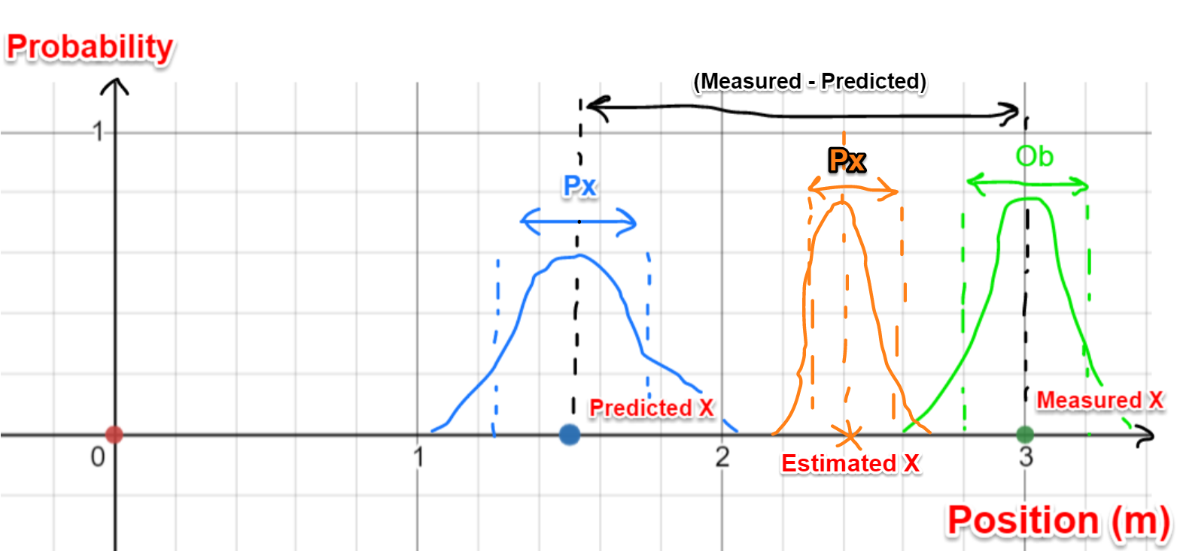

Estimating x
x _{Predicted} = x + v*t
- Predicted x
- Uncertainty of Prediction x
x _{Estimated} = x _{Predicted} + K * (x _{Measured} – x _{Predicted})
- Uncertainty of Estimated x

Slide 7
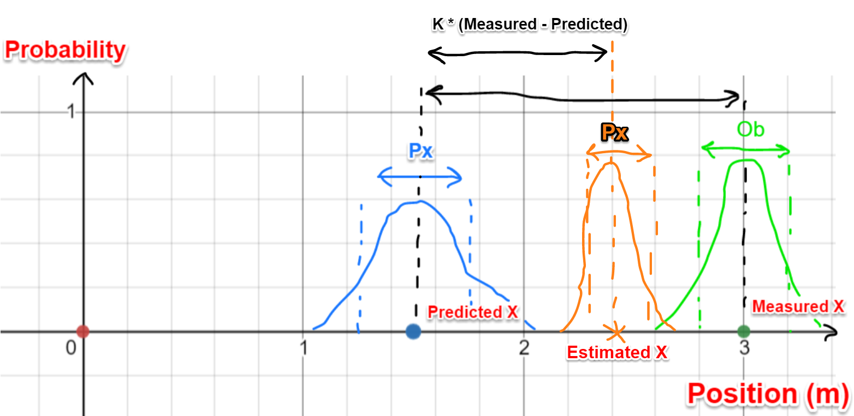


Kalman Gain, K
$$K=\frac{Uncertainty of Estimate}{Uncertainty of Estimate+Uncertainty in Measurement}$$
$$K=\frac{Px}{Px+Ob}$$
x _{Predicted} = x + v*t
- Predicted x
- Uncertainty of Prediction x
$$K=\frac{Px}{Px+Ob}$$
x _{Estimated} = x _{Predicted} + K * (x _{Measured} – x _{Predicted})
- Uncertainty of Estimated x

Slide 8
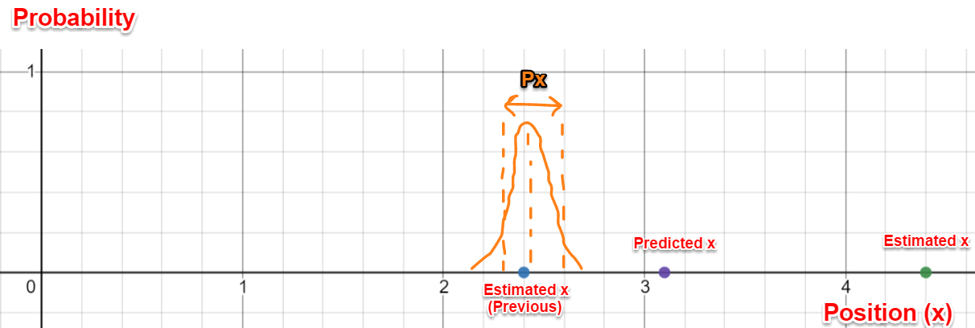

Re-iterate
x _{Estimate (Previous)}
x _{Predicted} = x + v*t
Px _{(Previous)}
$$K=\frac{Px}{Px+Ob}$$
x _{Estimated} = x _{Predicted} + K * (x _{Measured} – x _{Predicted})

Slide 9
Further Reading
Kalman Filter Tutorial - https://www.kalmanfilter.net
Tutorial Playlist - https://www.youtube.com/watch?v=CaCcOwJPytQ&list=PLX2gX-ftPVXU3oUFNATxGXY90AULiqnWT

